Slide 1
(Thesis 1) SIMULATIONS AND IMPLEMENTATION OF MAGNETIC MICROGRIPPERS FOR THE REMOVAL OF TEXTILE DYES IN WASTEWATERS
Diego F. Martinez

Slide 2
Index
Introduction
Objectives
Methodology
Partial Results
Future Work

Slide 3
Introduction
Water as an essential component to perform all human activities is a vital constituent of living organisms. However, the continued urbanization and population has had a high impact in the environmental development, diminishing potable water supplies and polluting oceans, aquifers, rivers, lakes, and groundwater at an unprecedented rate [1][2][3]. Some of the most common pollutants include pathogens, excess nutrients, suspended solids, sediments, pesticides, plastics, fertilizers, acids, detergents, phenols, minerals, and heavy metals which are discharged from homes, businesses, industry, cities, agriculture and the one we are focusing on this project is textile inks. [4][5][6].

Slide 4
OBJECTIVES AND SCOPE
Simulation and implementation of biomicromechanical devices for the removal of textile dyes from wastewaters.
Specific (Tesis 1)
❖ Select materials and appropriate surface functionalization strategies to conduct textile dyes removal processes from wastewaters.
❖ Engineer the geometry and simulate selected materials with suitable capacity to be implemented in the microstructures.
❖ Use software to simulate magnetic and mechanical responses of the microstructures and interactions among themselves.

Slide 5
Methodology
Three different simulations for each material tested.
One for simple interaction of the gripper and natural magnetic behavior
One for study the behavior of a gripper with changes like magnetic field, temperature, among others.
One for the study of interactions between two or more grippers.
Report of materials behavior and viability for real-life implementation
One final selected material with all simulations and characterization.
Optimal geometry chosen for the implementation of micro gripper. Thickness of
the multilayer and material description.

Slide 6
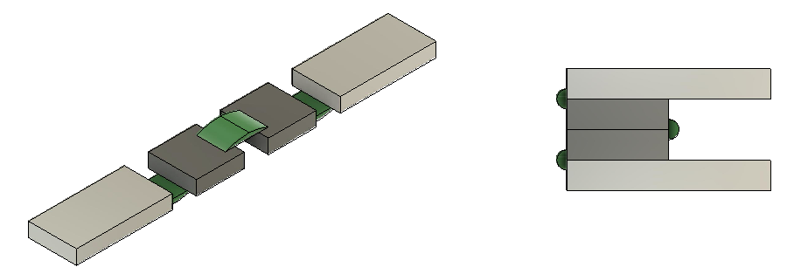
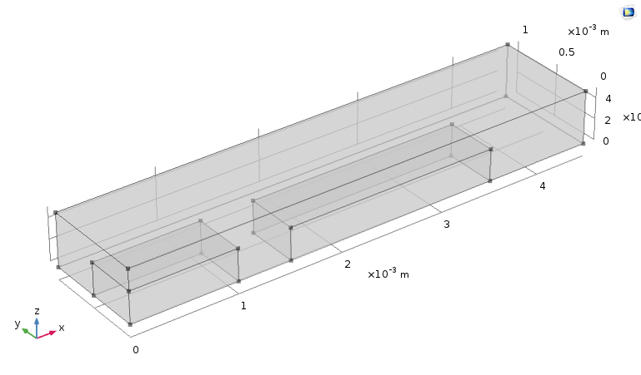
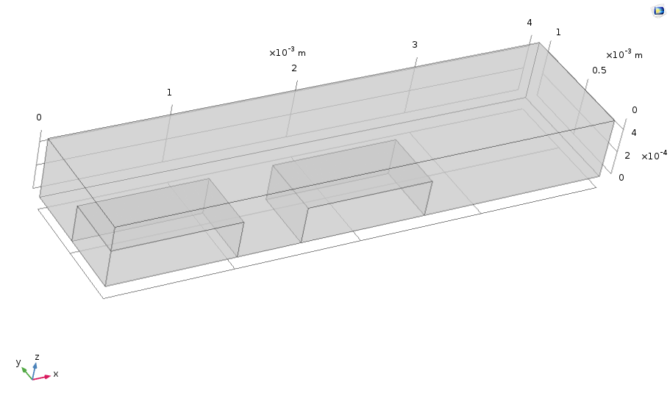
Inicial draft

Slide 7
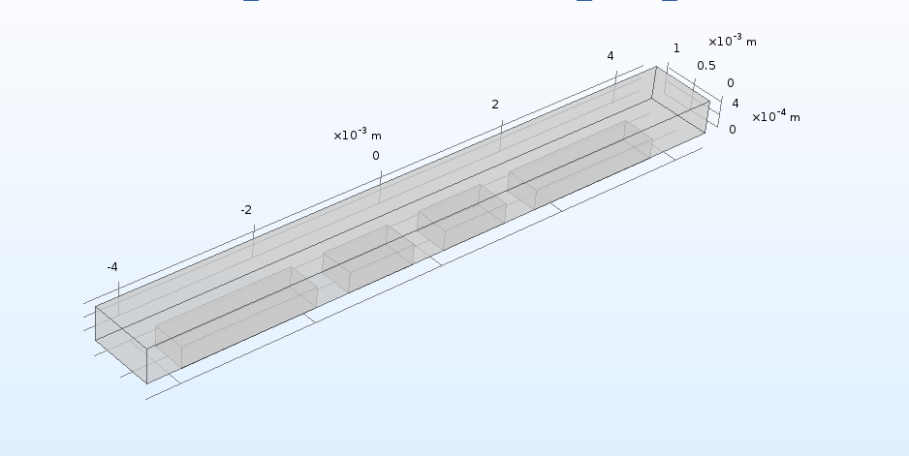

Slide 8
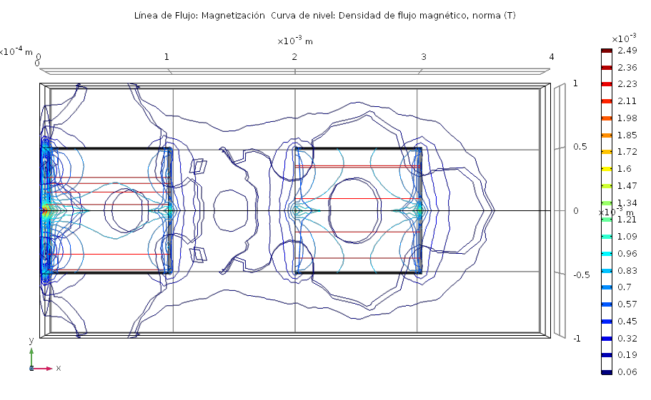
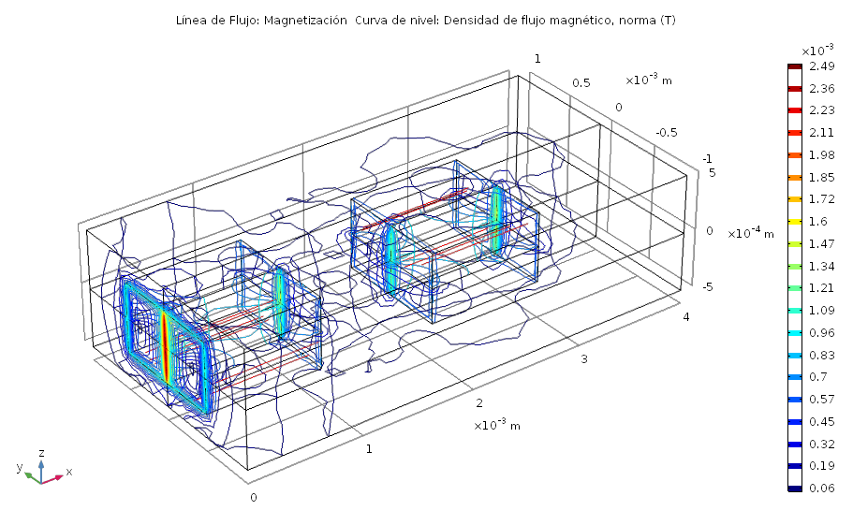
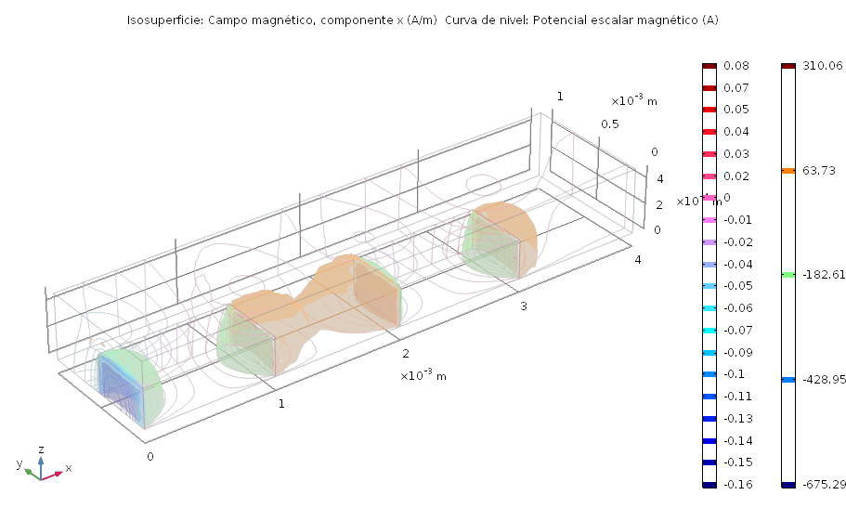
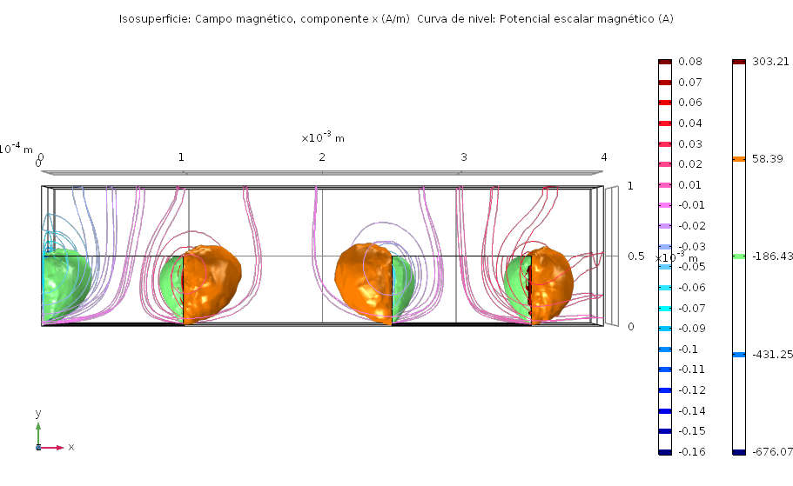
Magnet - Magnet

Slide 9
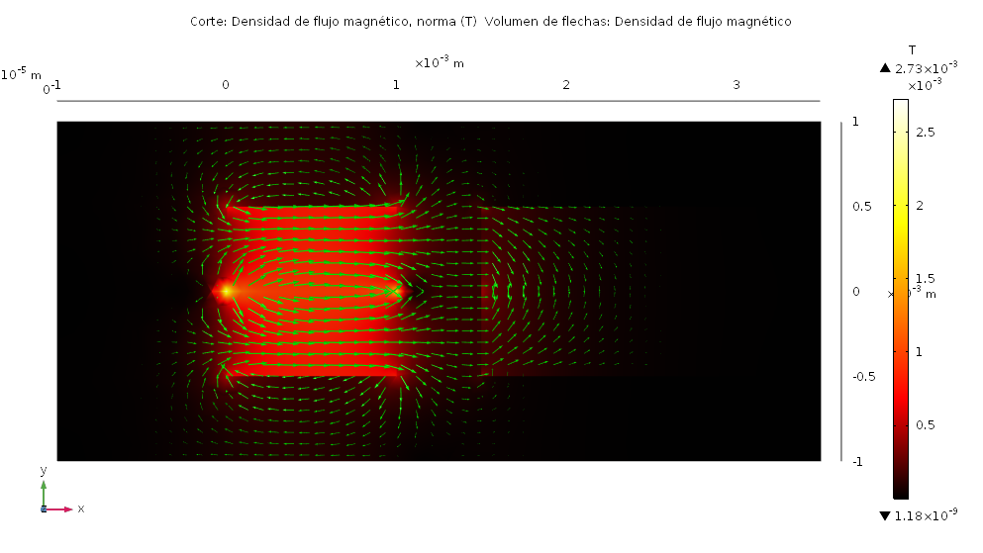
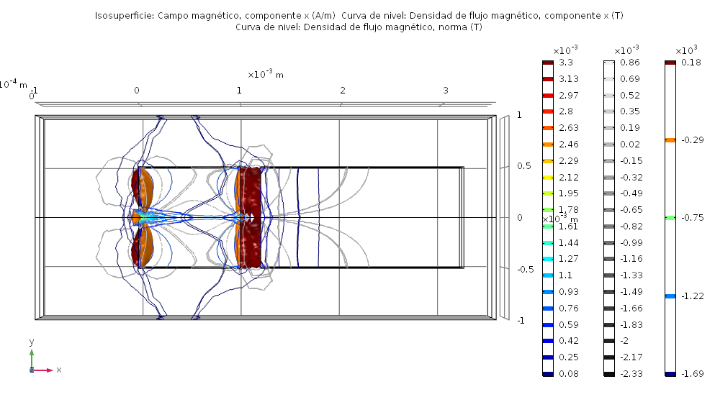
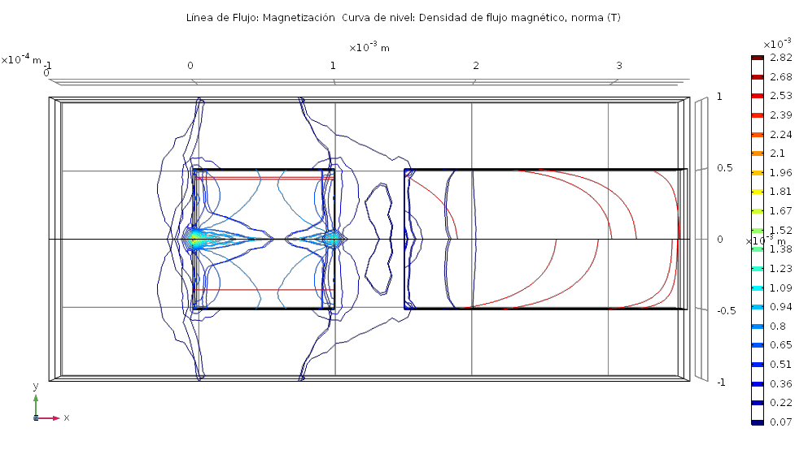
Magnet - Niquel

Slide 10
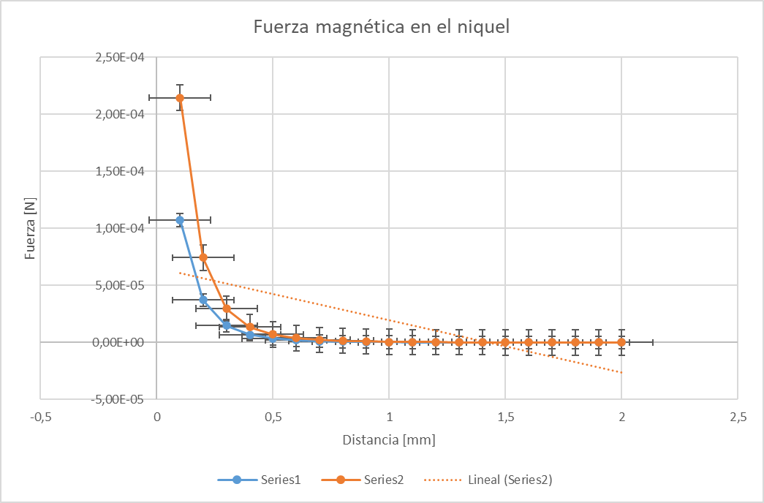

Slide 11
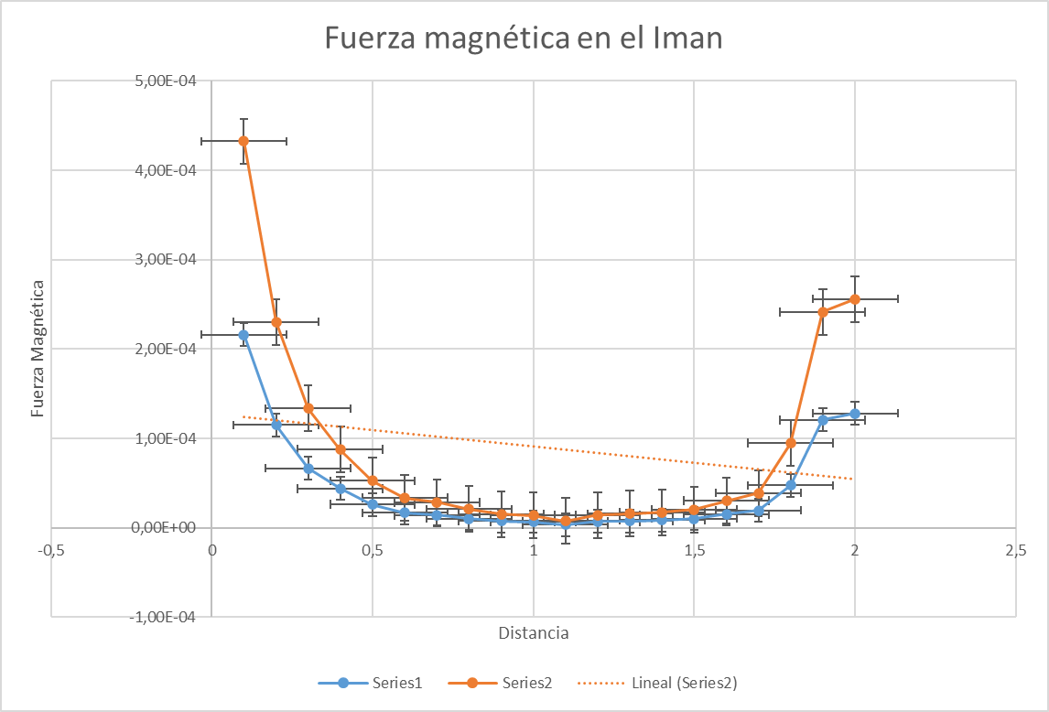

Slide 12
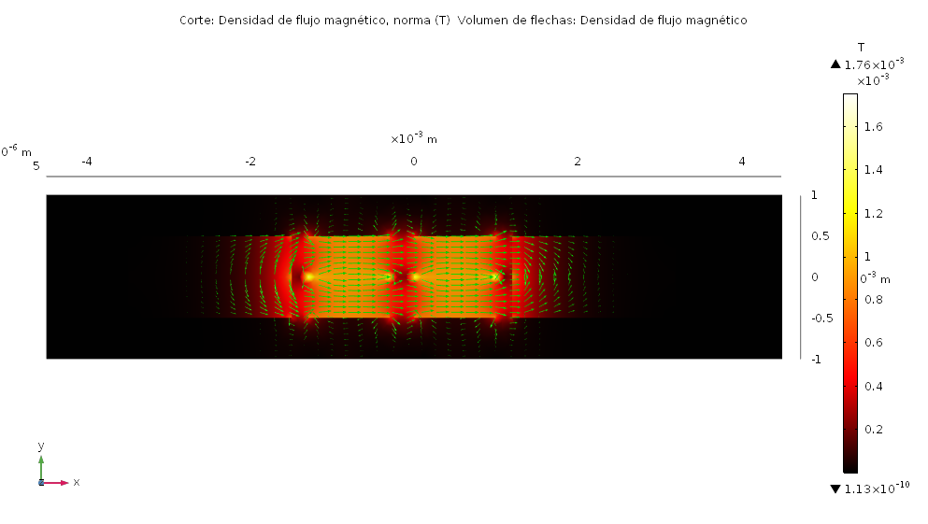

Slide 13
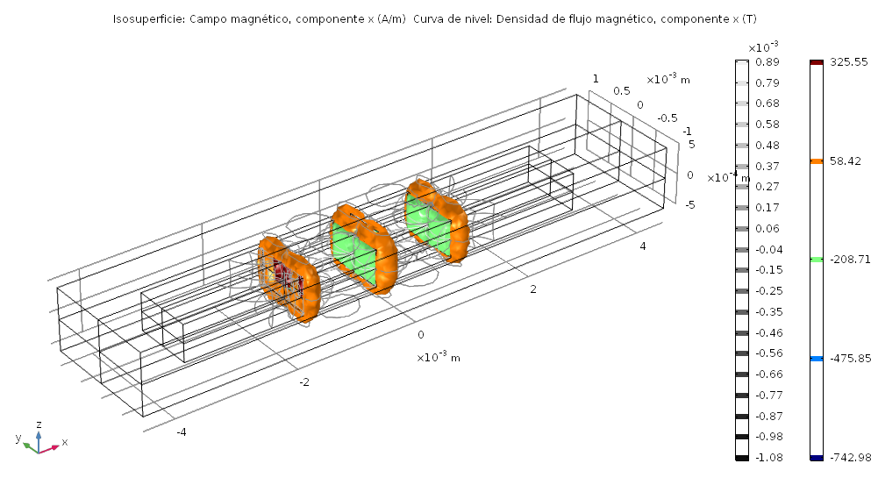

Slide 14
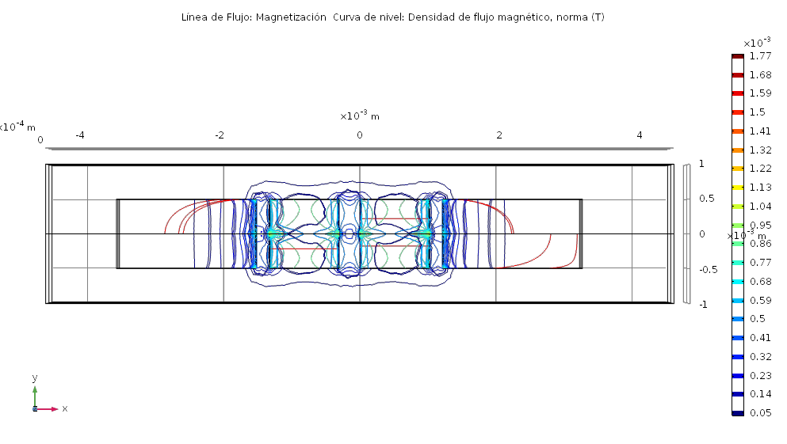

Slide 15
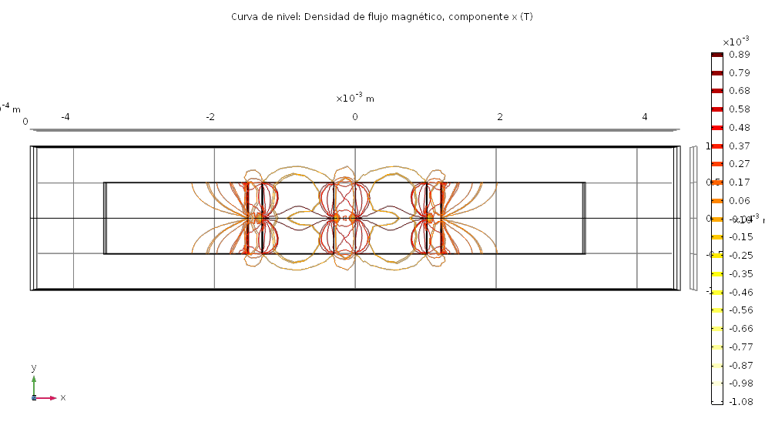

Slide 16

Future Work

Slide 17


Thanks!
Any questions?

